Slide 1


Flutter Development Path
Victor Carreras

Slide 2
Victor Carreras Jimenez
Mobile Chapter Lead
Capgemini

Slide 3
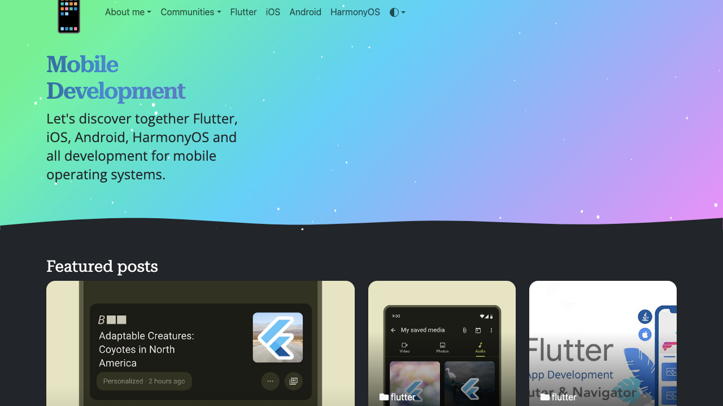


Slide 4
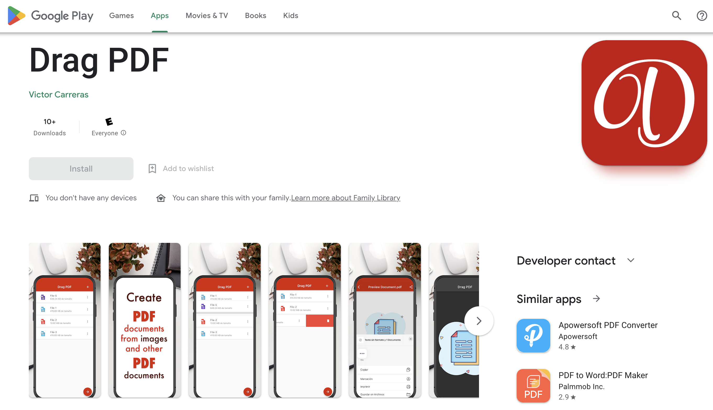

Slide 5
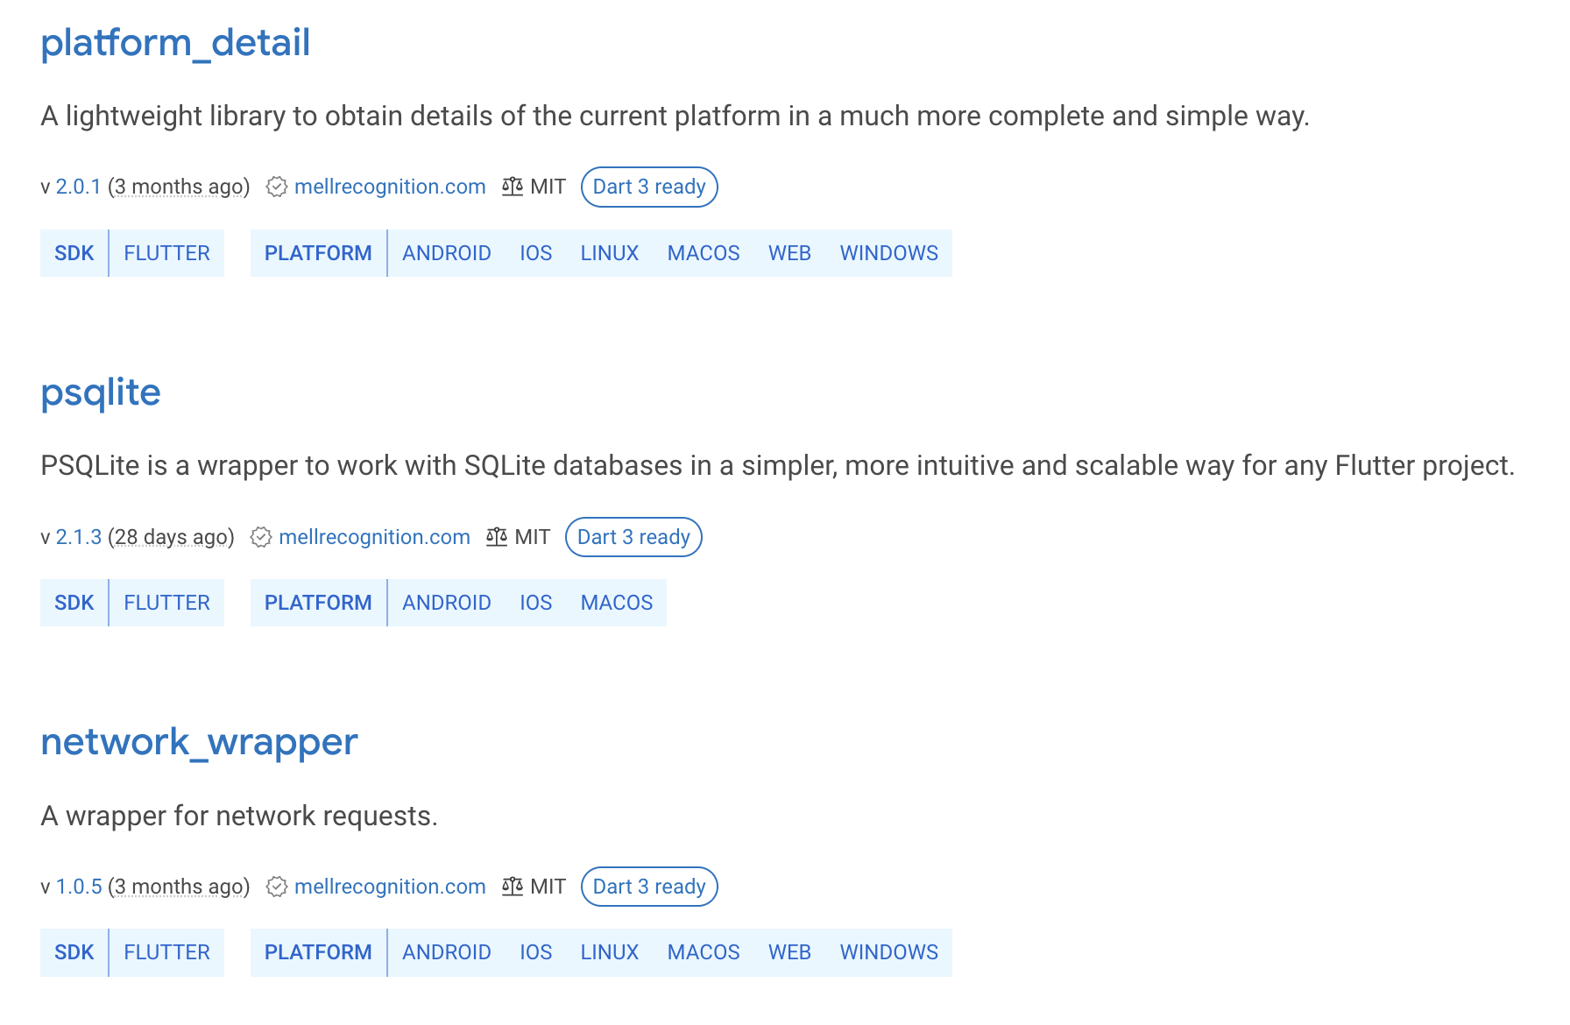

Slide 6
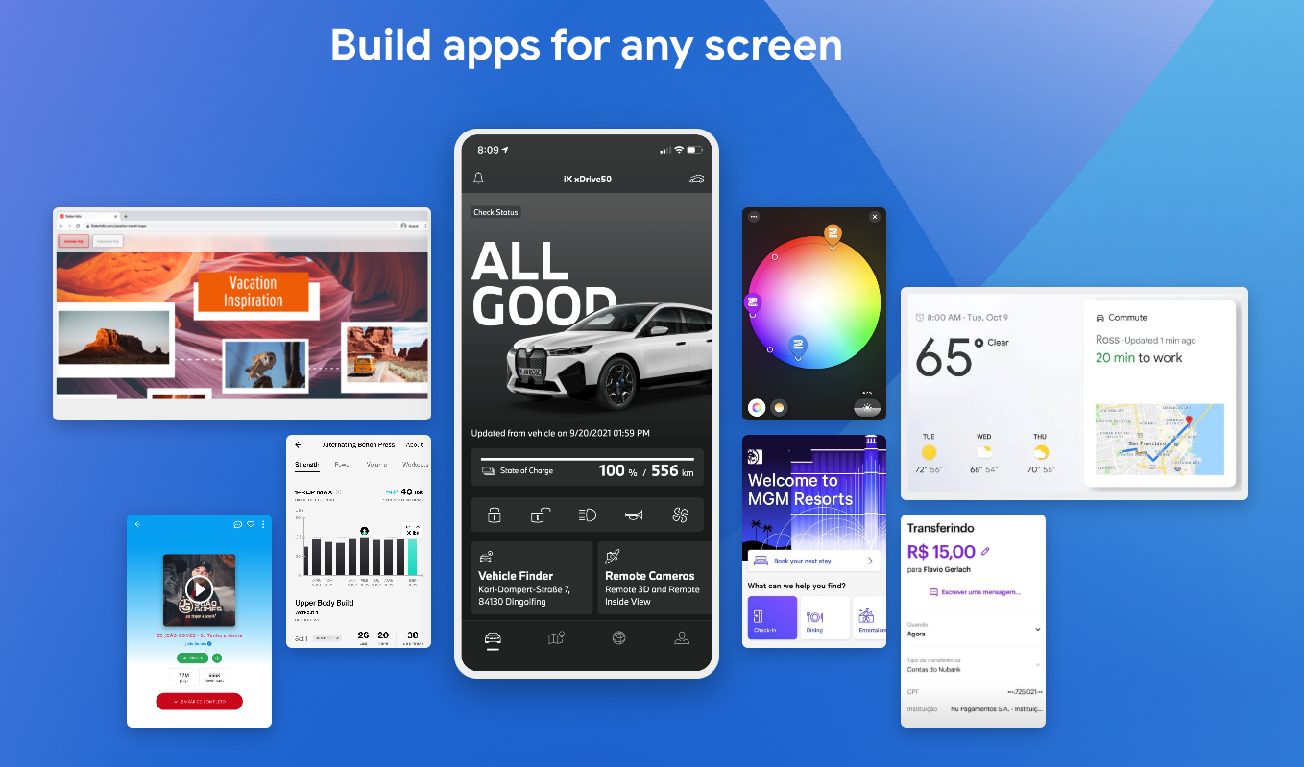

Slide 7


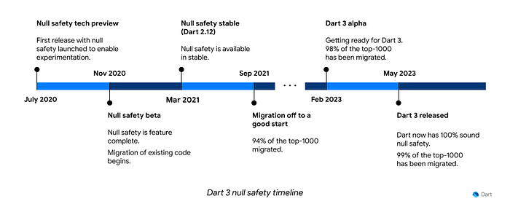

Slide 8
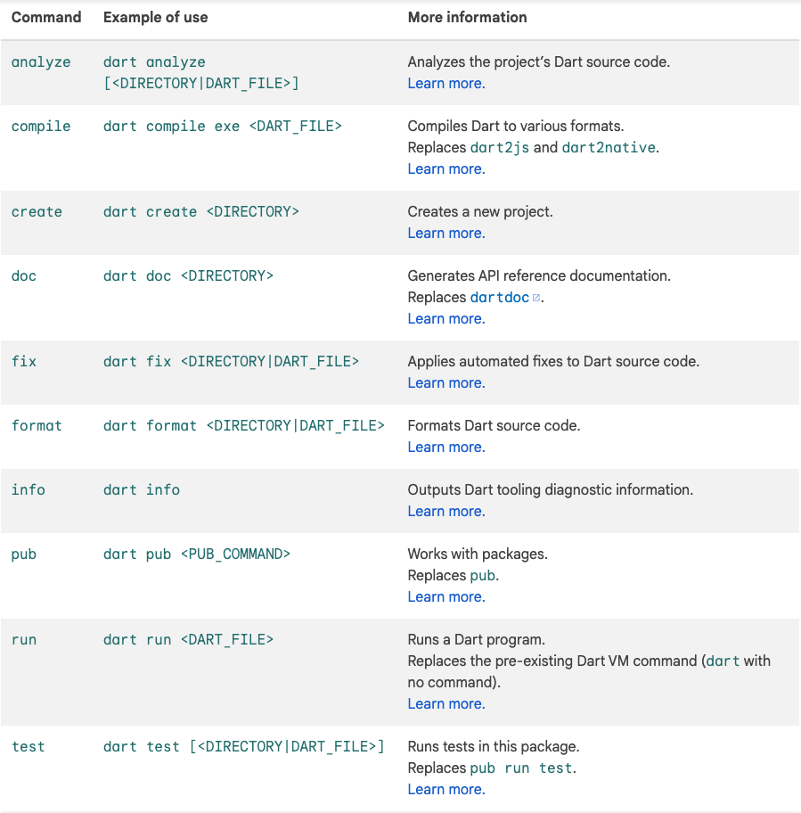
Dart SDK as command-line tool

Slide 9
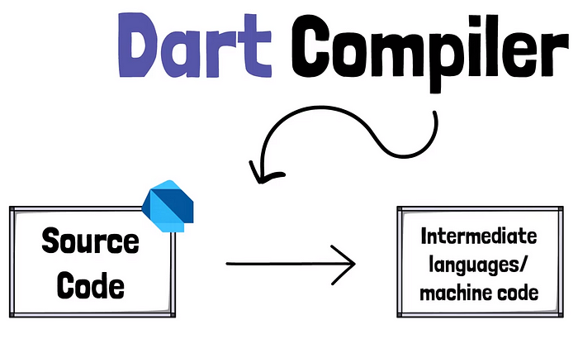
Dart uses JIT(Just in Time Compiler) and AOT(Ahead Of Time Compiler) for native.

Slide 10
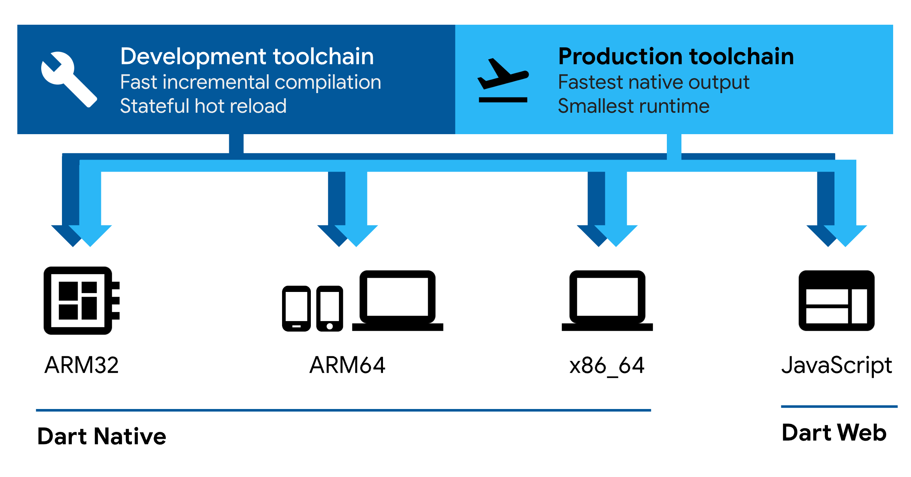

Slide 11
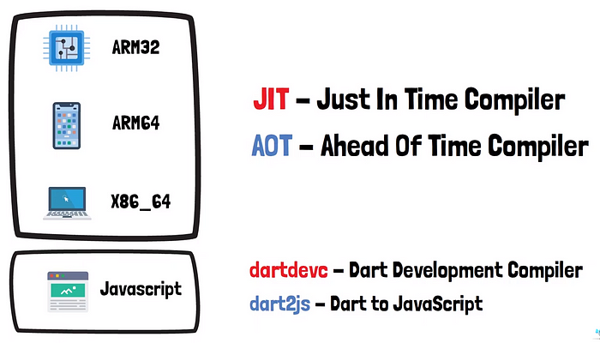
Web Assembly

Slide 12
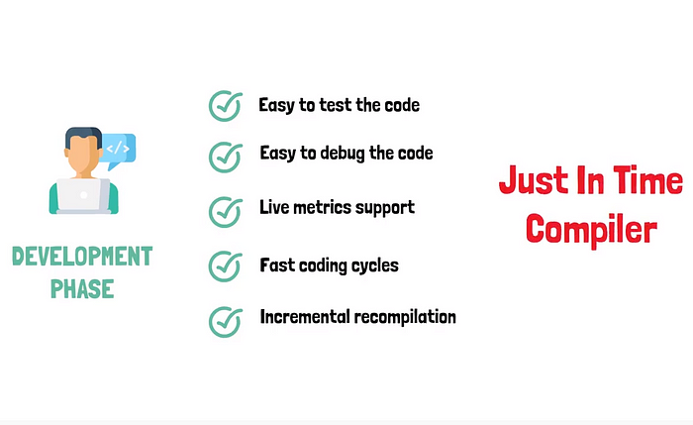
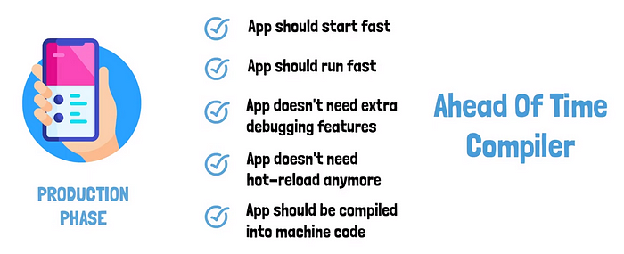
Which one is the best?

Slide 13
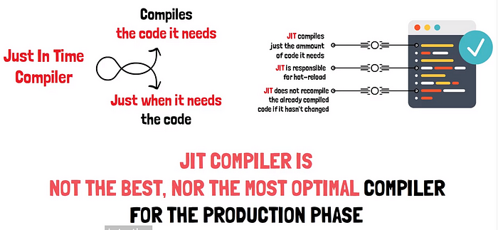

Slide 14

Hot Reload

Slide 15
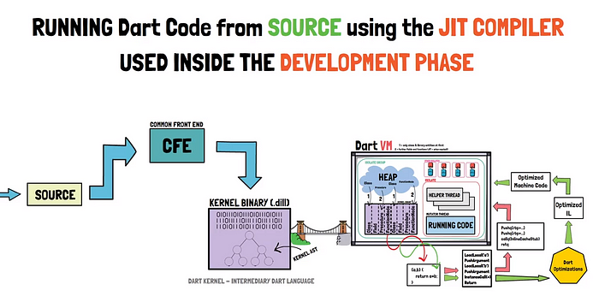

Slide 16
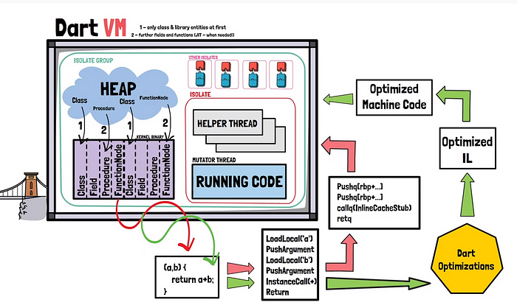

Slide 17
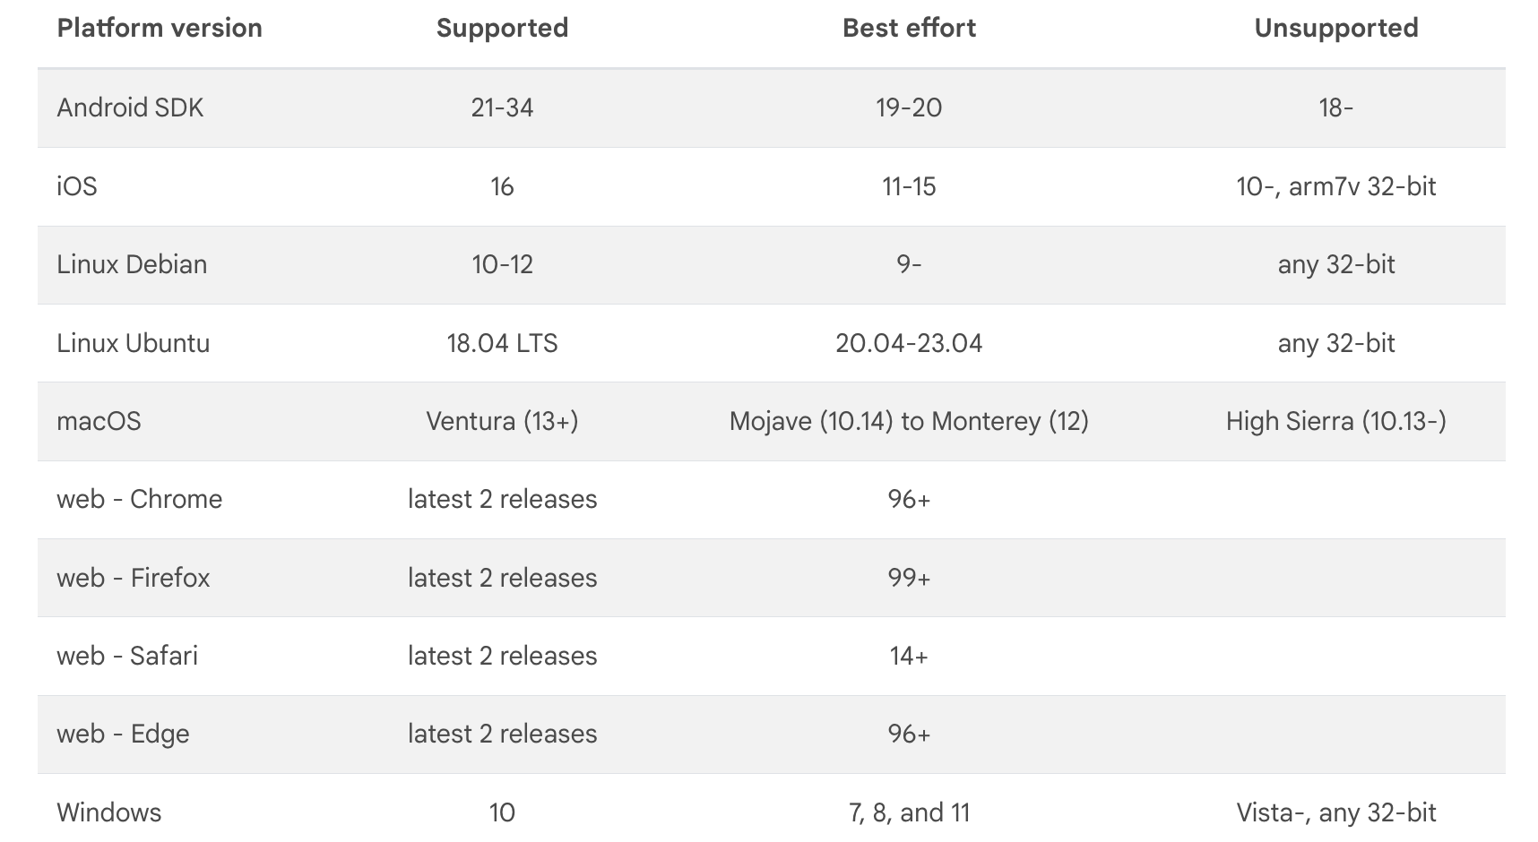

Slide 18

IMPELLER

Slide 19
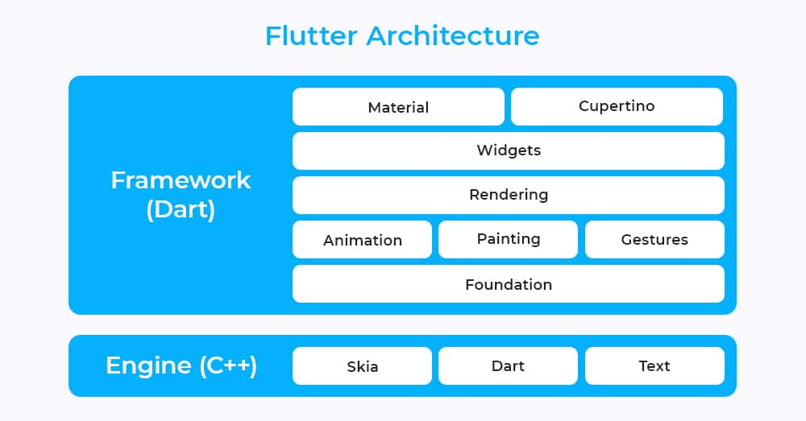

Slide 20

Thank you

